Slide 1

[IOT BASED FOOD SPOILAGE DETECTION SYSTEM]
By
SOHAN KUMAR SAHOO
Department of Computer Sc. and Engineering
Faculty of Engineering & Technology (ITER)
Siksha ‘O’ Anusandhan (Deemed to be) University
Bhubaneswar, Odisha

Slide 2
Presentation Outline
Introduction
Motivations
Uniqueness of the work
Literature Survey
Existing System
Problem Identification
Schematic Layout OR Model Diagram
Methods OR Tools OR Algorithms used
Experimentation and Results
System/Model Specifications
Datasets Description(if any)
Parameters used (if any)
Experimental outcomes (Tables and Figures)
Result Analysis and Validation
Conclusion and Future Scope (Key findings)
Bibliography

Slide 3
Introduction
Overview
A spoilage spot detection system is a project aimed at developing an intelligent system that can detect food spoilage by analyzing various factors such as temperature and gas levels. The system can be used to ensure food safety and prevent foodborne illnesses by detecting spoiled food before it is consumed.
The project typically involves developing a sensor system that can monitor the environmental conditions of food products in real-time. When the system is powered on, we will bring a object near the ultrasonic sensor and methane sensor then it connects with the internet via Wi-Fi modem and starts reading data from the interfaced sensors - DHT-11 temperature and humidity sensor and MQ4 Sensor. The Wi-Fi modem collects data from all the sensors and passes to the character OLED for display. The sensor data are then monitored visually Online which can process the data and provide alerts to the buzzer so that it will beep once it detects the spoiled food.

Slide 4
Introduction contd..
Motivations
There are several motivations behind an IoT project focused on food spoilage detection:
Food safety: Spoiled food can cause serious health issues to consumers, leading to foodborne illnesses. An IoT-based spoilage spot detection system can ensure that food products are safe for consumption.
Cost savings: Food spoilage can lead to significant losses for food companies. By detecting spoiled food early, companies can prevent the spread of spoilage to other products and reduce the amount of wasted food.
Quality control: An IoT-based spoilage spot detection system can help food companies maintain consistent quality in their products. By detecting and removing spoiled products early consumers.
Environmental impact: Food waste has a significant environmental impact, contributing to greenhouse gas emissions and other negative effects. By reducing food waste through early spoilage detection, an IoT-based system can help mitigate this impact.
Uniqueness of Proposed System
The uniqueness of this system lies in its ability to accurately detect the level of freshness in food items in real-time and it is applicable to all types of food items. It will detect if food is spoiled or not along with this it will also show the temperature and humidity, smoke and LPG value.

Slide 5
Literature Survey
Title | Authors | Year | Publication | Findings of the study
Machine learning techniques for food spoilage. | Garcia M.et al. | 2019 | IEEE Transactions on industrial informatics. | It presents overview of diff. ML algorithms in analyzing sensor data for spoilage detection.
A smart Iot-based system for real-time food spoilage detection and monitoring. | Lee,S.et al. | 2021 | Computers in industry | It describes the architecture with sensor nodes, data collection and cloud based analytics.
Iot-enabled freshness monitoring system for perishable food. | Wang, L.et al. | 2018 | Computers and electronics in agriculture | Continuous monitoring and analyzing environmental condition to detect food spoilage.
An AI approach towards food soilage detection and analysis | Ekta sonwani, Roobaea Alroobaea, Urvasi Bansal | 2022 | Digital public health | It utilizes image processing techniques to analyze visual characteristics and patterns of food items. By capturing images they extracted relevant features and employed machine learning algorithms.

Slide 6
Literature Survey Contd..
Problem Identification
Spoiled food can cause serious health issues for consumers, lead to financial losses for food companies, and have a negative impact on the environment. Traditional methods of detecting spoilage, such as visual inspection, are time-consuming and prone to errors. Therefore, there is a need for an automated, real-time system that can detect spoilage early and prevent the spread of contamination.
Food products pass through various stages in the supply chain, involving multiple entities like farmers, processors, distributors, and retailers. The lack of visibility and coordination across these stages can lead to inefficiencies and increase the likelihood of spoilage. Tracking the origin, storage conditions, and handling of food products becomes challenging without an efficient system in place.

Slide 7
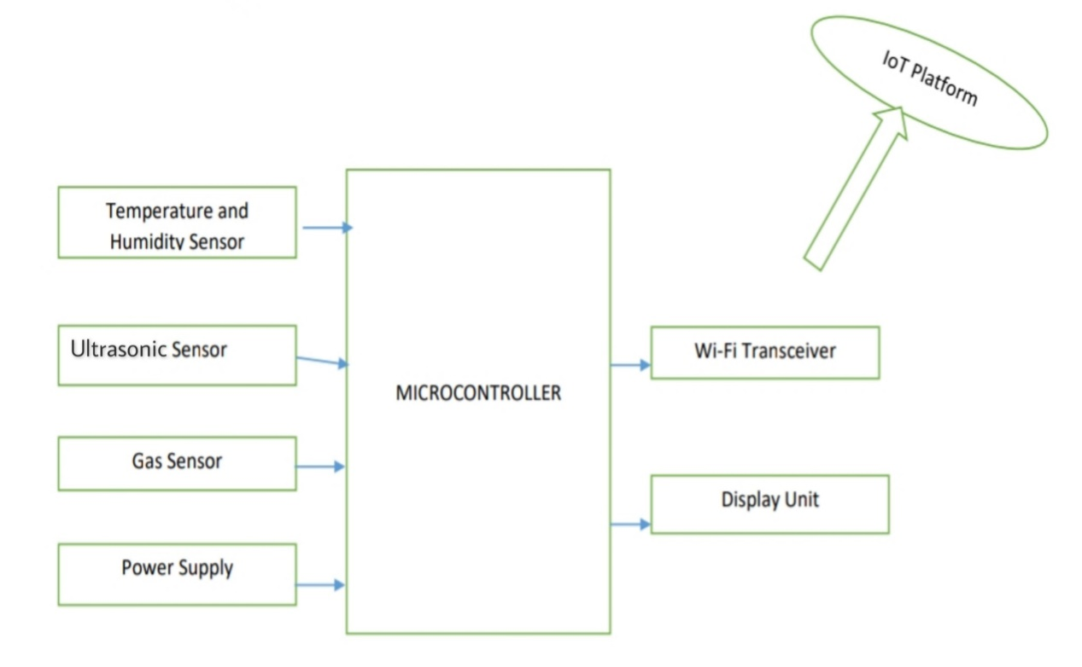
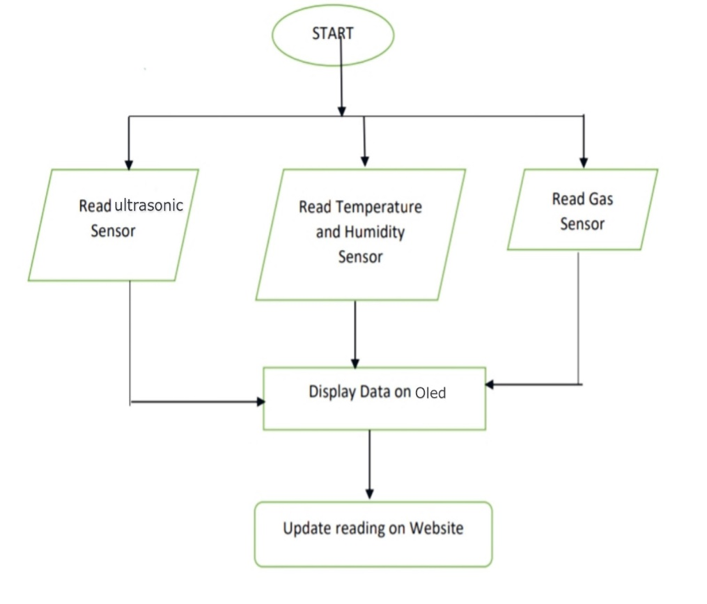
Schematic Layout OR Model Diagram
Fig.1
Fig.2
Block diagram
Flow Chart

Slide 8
Methods OR Tools OR Algorithms used
The first step in developing a spoilage detection system is to integrate sensors into the system. Spoilage spot detection system involves using sensors to monitor food products for signs of spoilage, such as changes in temperature, humidity, and gas concentrations. Sensors can be placed at various points in the food supply chain, such as during storage, transportation, and retail, to detect spoilage in real-time.
The tools that are used in Spoilage spot detection system are:-
Raspberry Pi-Pico
Oled
Ultrasonic Sensor
Methane sensor
Temperature and Humidity sensor
Buzzer
Jumper wires

Slide 9
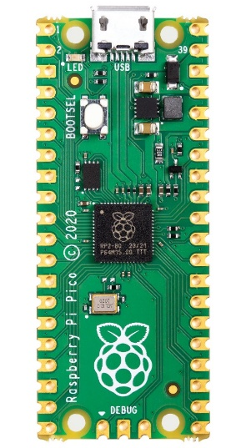
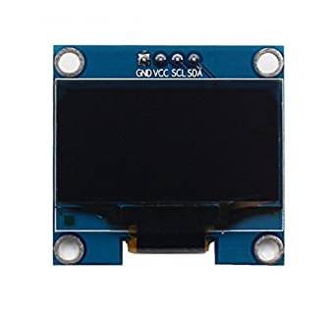
Methods OR Tools OR Algorithms used Contd..
Raspberry Pi Pico
Raspberry-Pi Pico is a microcontroller board that is widely used in IoT projects as it is a low-cost, high-performance microcontroller board.
The Raspberry Pi Pico has low power consumption and can be powered using a USB cable, making it easy to connect to a computer or a power source.
OLED
Fig.3 (Raspberry Pi Pico)
OLED (Organic Light Emitting Diode) technology is widely used in IoT projects as the displays are thin, lightweight, and energy-efficient, making them perfect for use in low-power devices.
OLED displays can be used in IoT sensors to display data about the environment, such as temperature, humidity, and air quality.
Fig.4 (Oled)

Slide 10
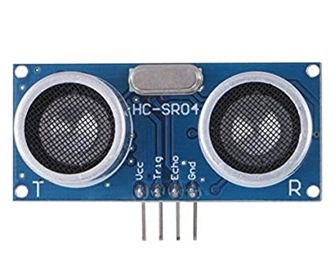
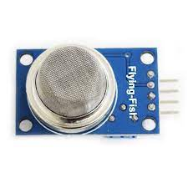
Methods OR Tools OR Algorithms used Contd..
Ultrasonic sensor
These sensors are widely used in Internet of Things (IoT) projects to measure distance, proximity, and motion.
In an IoT project, an ultrasonic sensor typically consists of a transmitter and a receiver. The transmitter emits a high-frequency sound wave, which travels through the air and the receiver then detects the reflected sound wave and calculates the distance between the sensor.
Fig.5(Ultrasonic sensor)
Methane sensor
A methane sensor is a device used to detect the presence of methane gas in the environment. Methane is a highly flammable and explosive gas that is commonly found in natural gas and petroleum deposits.
These sensors can detect the presence of methane gas in the air and provide real-time data to IoT platforms, allowing for prompt action to be taken in the event of a leak or other hazardous situation.
Fig.6 (Methane sensor)

Slide 11
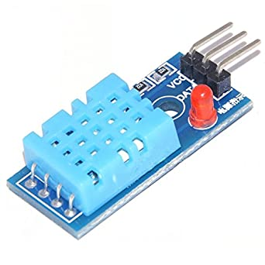
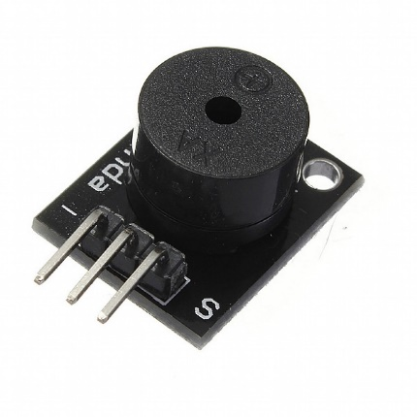
Methods OR Tools OR Algorithms used Contd..
Temperature and humidity sensor
Temperature and humidity sensors are commonly used in IoT projects to measure the environmental conditions of a given space.
Temperature sensors measure the ambient temperature of a given environment. Humidity sensors, on the other hand, measure the amount of moisture in the air. Humidity sensors can be either capacitive or resistive.
Fig.7 (Temperature and humidity sensor)
Buzzer
A buzzer is a common component used in IoT projects to provide an audible alert or notification. It is a small, inexpensive, and simple device.
The buzzer can be activated by sending a digital signal from a microcontroller or other device to the driver circuit, which then activates the buzzer.
Fig.8 (Buzzer)

Slide 12
Experimentation and Results
System Specifications
Temperature: Measure and monitor the temperature of the food storage environment and the food if its hot or cold.
Humidity: Monitor the humidity levels within the food storage area. High humidity can promote the growth of mold and bacteria, leading to spoilage.
Gas levels: Detect and measure the presence of methane gas. Certain fruits, vegetables and meat release methane, which accelerates ripening and can lead to spoilage. Monitoring gas levels can help identify the stage of ripening or decay and issue appropriate alerts.
Real-time data monitoring: Collect and analyze all the sensor data in real-time. It Uses data analytics techniques to detect the spoilage and generate actionable insights.
Connectivity: Ensure the system has reliable connectivity, either through Wi-Fi, or other wireless protocols that can be used for communication between the sensors and the central system..
User/web interface: Developed a user-friendly interface for users to visualize and interact with the collected data. This interface should provide real-time information and historical trends.
Compatibility: Ensure compatibility with existing infrastructure and technologies used within the food industry.

Slide 13
Experimentation and Results Contd..
Datasets Description
Several datasets have been used in studies related to spoilage of food detection using IoT systems.
One such dataset is the Food Spoilage dataset, which was created by Wang et al. (2020). The dataset consists of images of spoiled and fresh food products, along with temperature and humidity readings collected using sensors. The dataset was used to train and test a deep learning model for food spoilage detection.
Another dataset is the Food Quality Inspection dataset, which was created by Zhang et al. (2018). The dataset consists of images of food products taken from various angles, along with information on the food's freshness and quality. The dataset was used to train and test a deep learning model for food quality inspection.

Slide 14
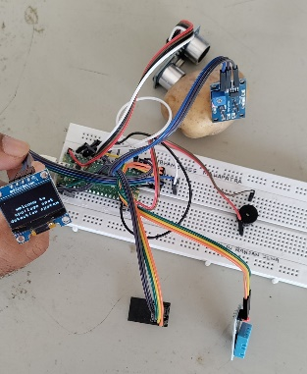
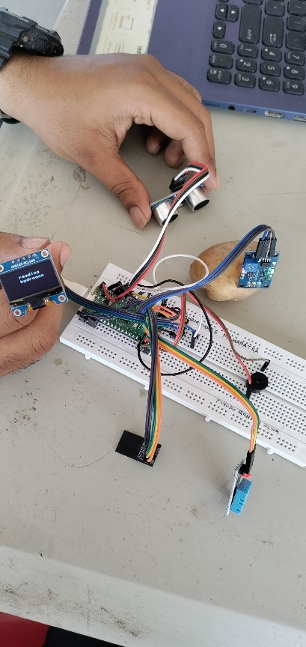
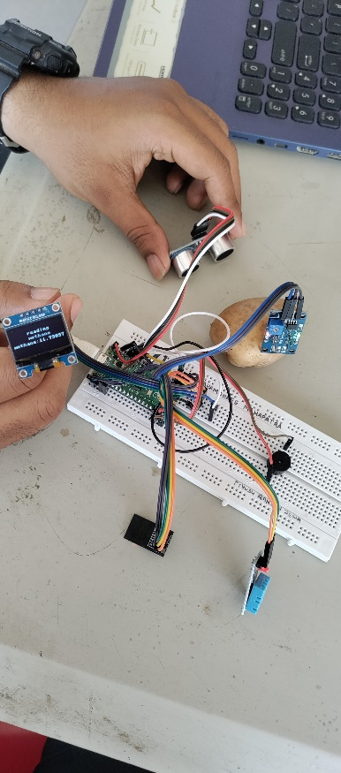
Experimentation and Results Contd..
Experimental outcomes
(Fig.9)
(Fig.10)
(Fig.11)
Step 1:Detection of object
Step 2:Reading Hydrogen and methane values

Slide 15
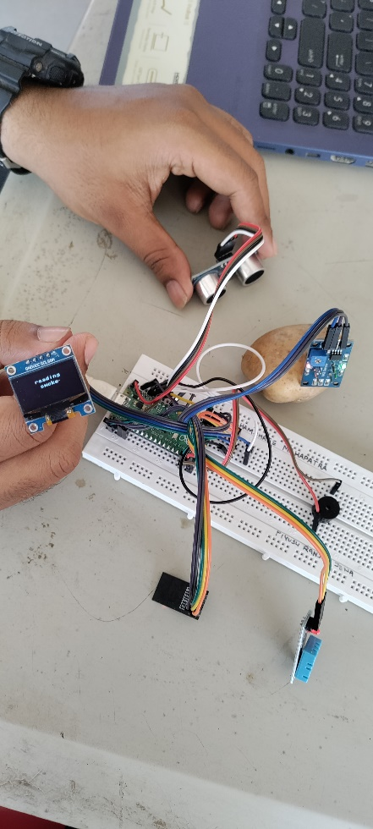
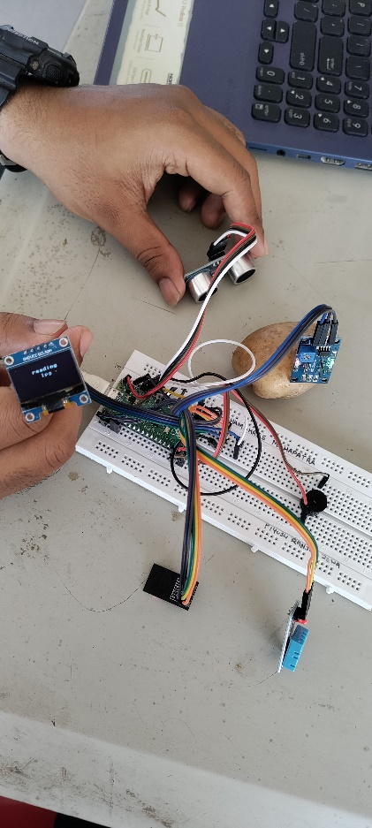
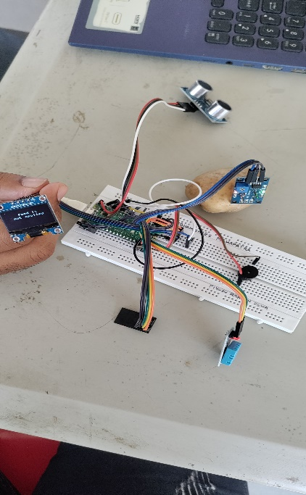
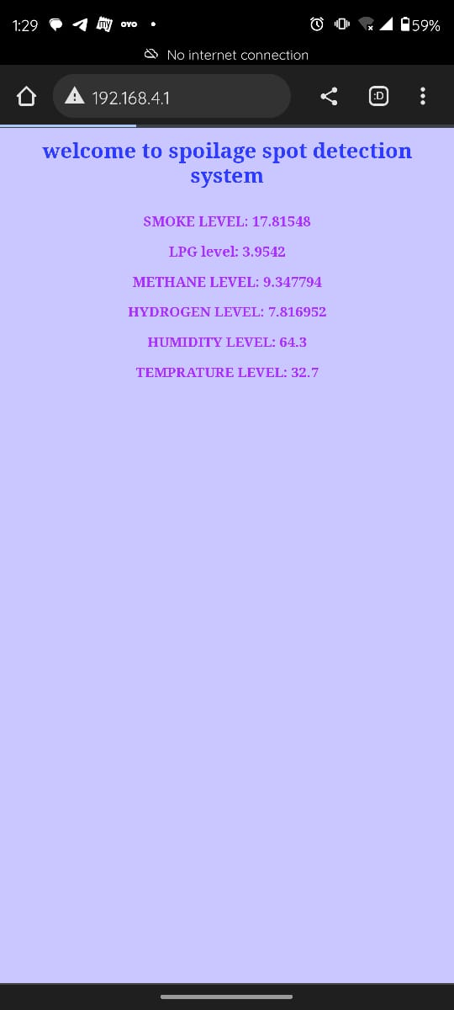
Experimentation and Results Contd..
(Fig.13)
(Fig.12)
Step 3: Reading Temp. humidity value and smoke value
(Fig.15)
In (Fig.14)
the food is not spoiled.
Step 4: Display of result

Slide 16
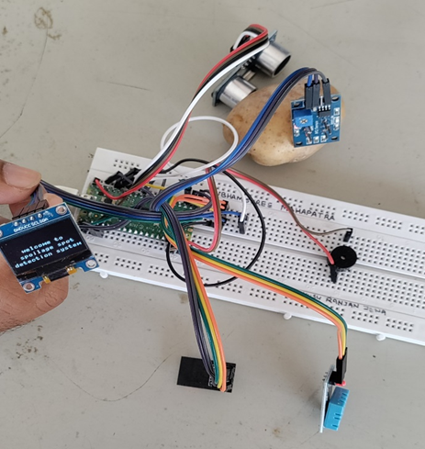
Result Analysis and Validation
Based on the analysis of these factors, we can identify areas of success and areas that require improvement in our IoT project for spoilage spot detection system.
Accuracy: Assess the accuracy of the system in detecting food spoilage. Compare the actual spoiled items with the system's detection results.
False Alarms: Analyze the instances where the system incorrectly identified non-spoiled items as spoiled. Determine the frequency and reasons behind false alarms.
Cost and Maintenance: Consider the cost of implementing and maintaining the system.
Validation
Step 1: Place the food near the ultrasonic sensor and methane sensor
so that the ultrasonic sensor can detect the object and mq4 sensor
can detect the methane level of food.
(Fig.16)

Slide 17
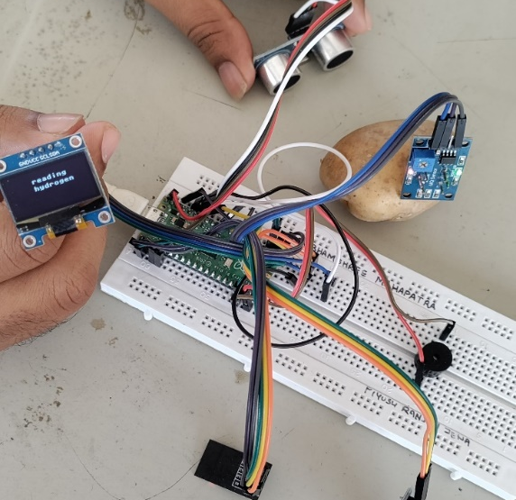
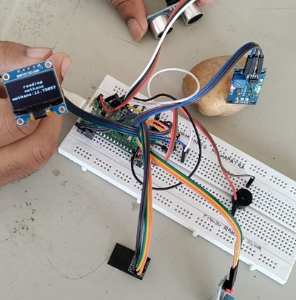
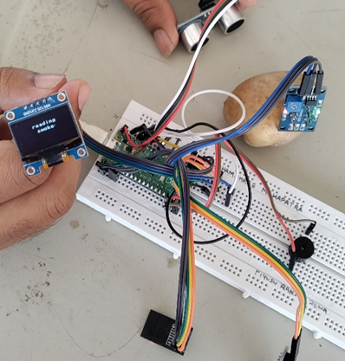
Validation Contd..
Step 2 : After detection of food it will start showing the Temp. and humidity, lpg and smoke values as well as the hydrogen level, and methane level present in food through oled.
(Fig.17)
(Fig.18)
(Fig.19)

Slide 18
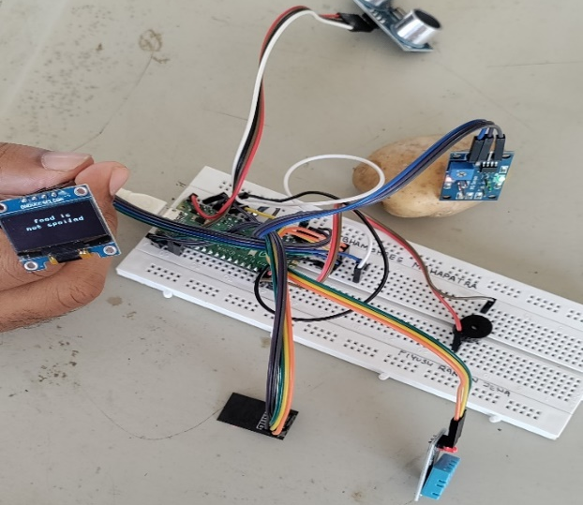
Validation Contd..
Step 3: After showing all the values the Buzzer will start beeping in two different tunes according to the food quality and the oled will display if food is spoiled or not.
(Fig.20)
Step 4: Displaying all the values in a website interface that is connected through the Wi-Fi modem.
(Fig.21)

Slide 19
Conclusion
IoT-based solutions for detecting food deterioration provide substantial advantages in terms of assuring food safety, upholding quality control, and reducing waste, so let's sum it up. These systems use sensor technologies, data analytics, and in-the-moment monitoring to identify spoiling early on, allowing for prompt mitigation and action. These systems enable precise and consistent spoiling detection, lowering the risk of foodborne diseases and maintaining the quality of food items by continually monitoring crucial parameters and utilising modern analytics techniques, such machine learning and computer vision. By integrating IoT technology, the food supply chain may benefit from increased traceability and proactive decision-making through the easy collection, analysis, and exchange of data.

Slide 20
Future scope
Improved Sensor Technology: As sensor technology continues to be researched and developed, more advanced and affordable sensors that can monitor a wider range of parameters, such as specific gas emissions, biochemical changes, or microbial activity, for more accurate spoilage detection may be developed.
The system can be integrated with other IoT devices in the kitchen, such as smart refrigerators, to optimize food storage and reduce food waste.
We can modify this project and use for big warehouses and go downs where manually
checking of eatables is not possible.
This system can also be used by anyone who owns refrigerator or may not having
refrigerator as sometimes person may forget to consume any food item before its expiry
date so it gets spoiled and is overlooked so its can be useful to detect freshness of each
item present in the fridge or else at home. In that also different sensors can be used.

Slide 21
Bibliography
Y. Gu, W. Han, L. Zheng and B. Jin, “Using iot technologies to resolve the food safety problem; an analysis based on chinese food standards”, [2012].
T. J. Ross and others, “Fuzzy logic with engineering applications, vol. 2”, [2004].
J. He, Z. Zhang, Y. Gu, J. Wang and others, "Technologies, applications, and governance in the internet of things," [2011].
A. Azad, S. Akbar, S. Mhaisalkar, L. Birkefeld and K. Goto, "Solid-state gas sensors: A review, Journal of the Electrochemical Society, vol. 139”, [1992].
C.-J. Du and D.-W. Sun, "Learning techniques used in computer vision for food quality evaluation: a review,vol. 72”,[ 2006].
Smith, J.et al, “Iot-based food spoilage detection system; A review of technologies and challenges”,[2022].

Slide 22


